Slide 1

An analysis of the new York knicks USING DATA science
Abhijay Upadhyay

Slide 2
Part 1: introduction to the datasets

Slide 3
Dataset Details
Datasets were downloaded from Basketball Reference. https://www.basketball-reference.com/
2 Datasets were downloaded
- 1 contained team stats for all teams this season.
- 1 contained stats from every Knicks game this season.
Both datasets have things like points, field goal %, rebounds, assists, steals, and other general basketball statistics.

Slide 4
Part 2: Dataset preprocessing

Slide 5
Modifying And Cleaning The Data
Data was modified to invent new statistics that better account for team differences when comparing different teams.
Used Data Mining algorithm Random Forest to find and remove irrelevant attributes.

Slide 6
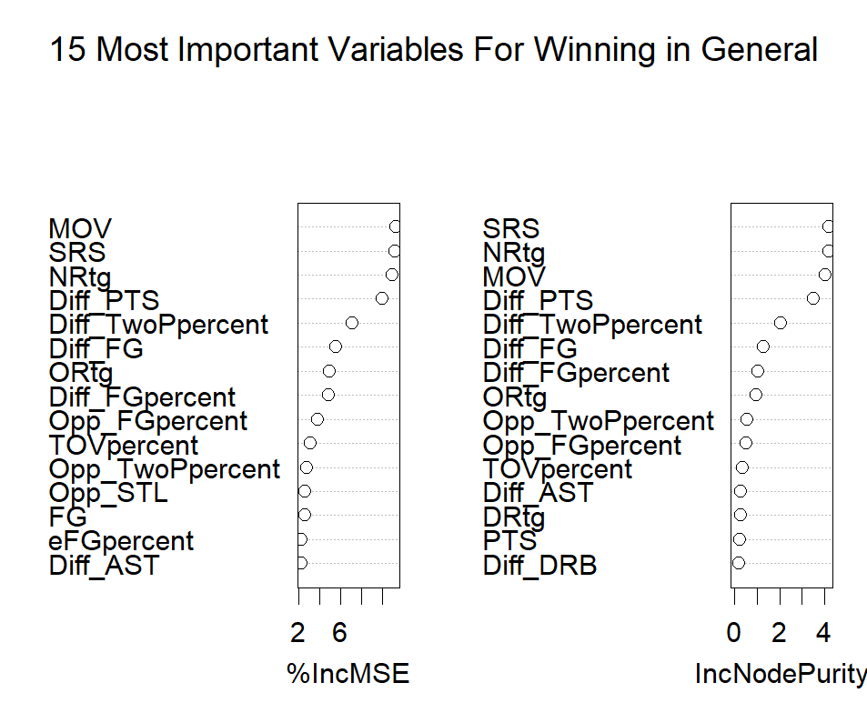
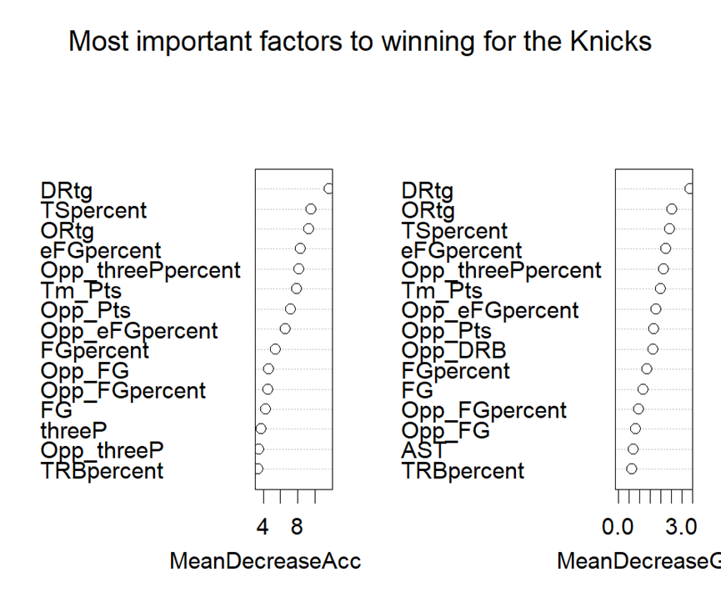
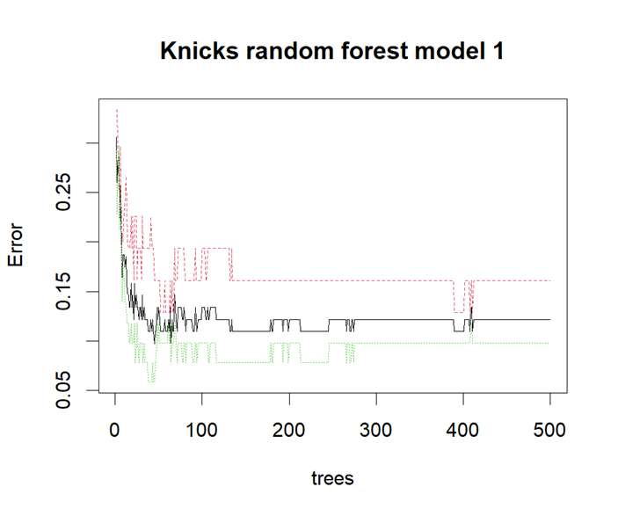
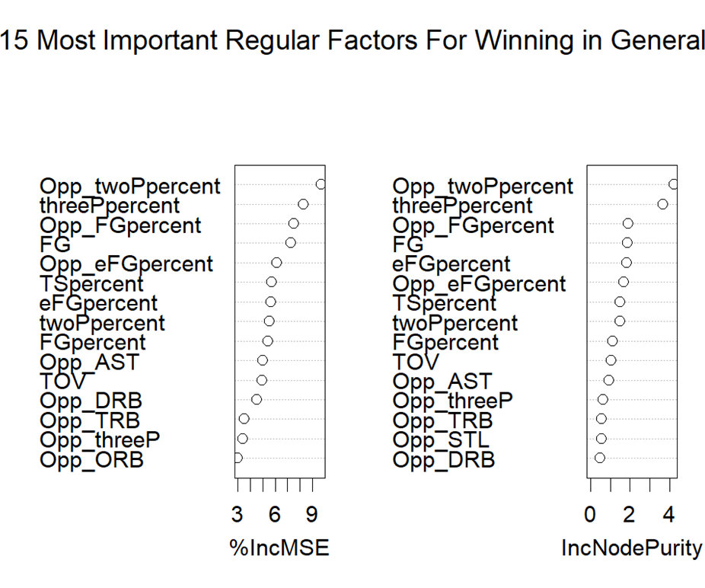
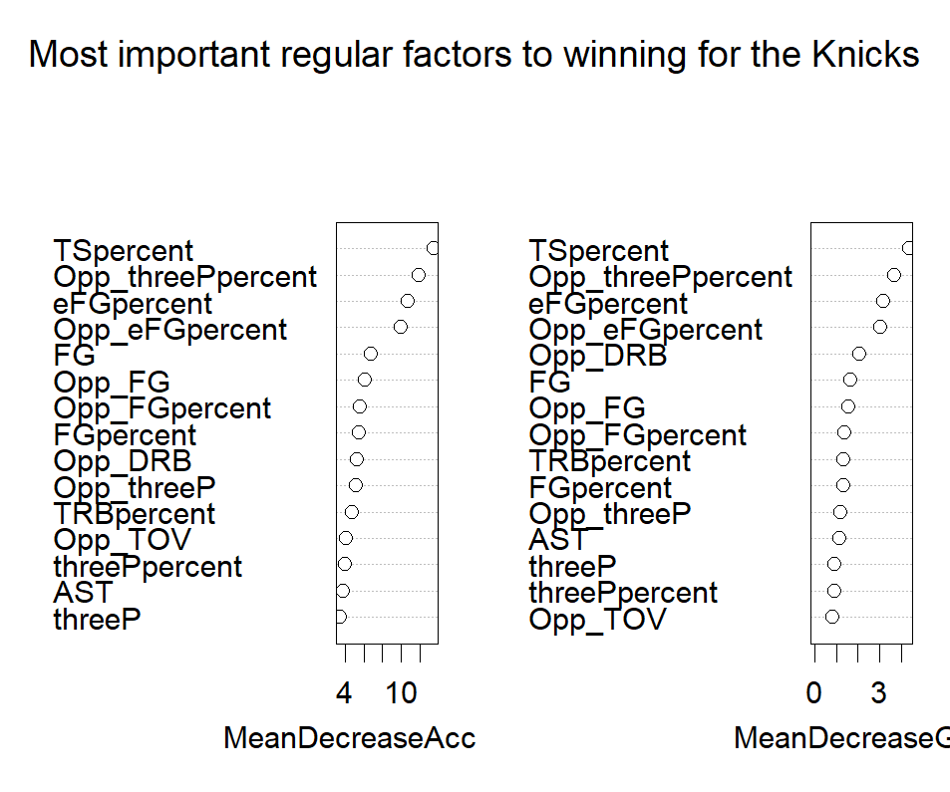
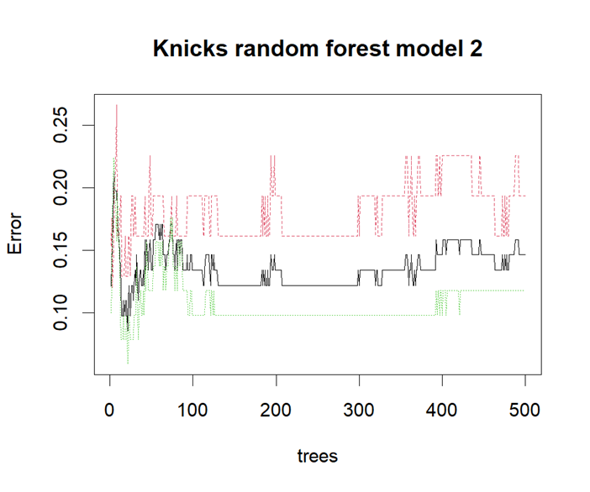
Preprocessing Graphs

Slide 7
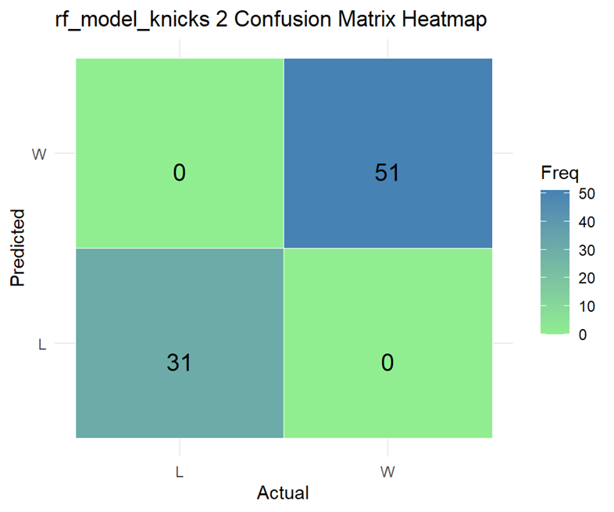

Slide 8
A Brief Explanation Of The Last Slides
Used random forest to find irrelevant variables.
Removed variables based off findings and contextual knowledge.
After removing irrelevant variables, ran data mining algorithms again to check errors and new findings.

Slide 9
Part 2: Data Visualizations and insights

Slide 10
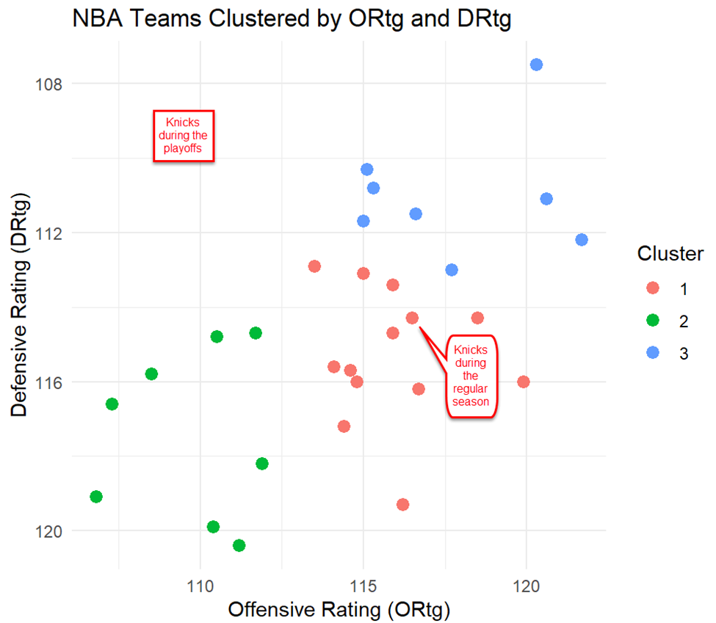
Using K Means Clustering
Used offensive and defensive rating to put every NBA team into a cluster.
Blue represents elite teams, red represents okay teams, and green represents bad teams.
Knicks are good but not amazing at defense and offense.
In the playoffs, they have become better at defense and worse at offense.

Slide 11
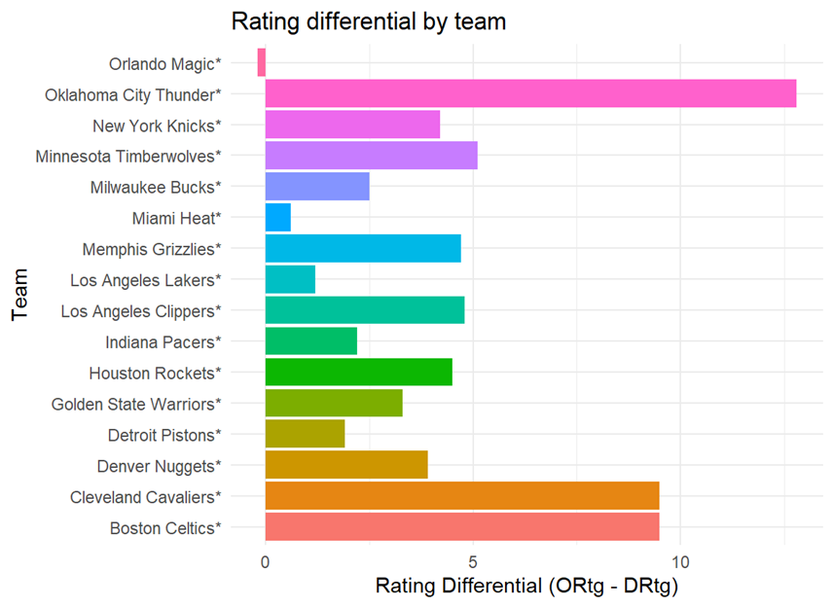
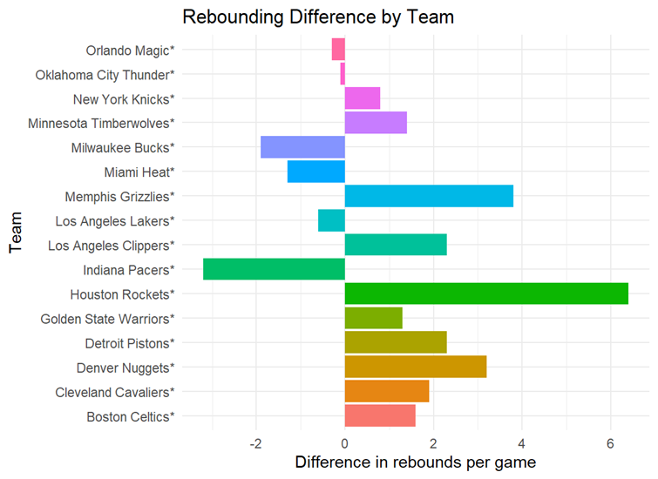
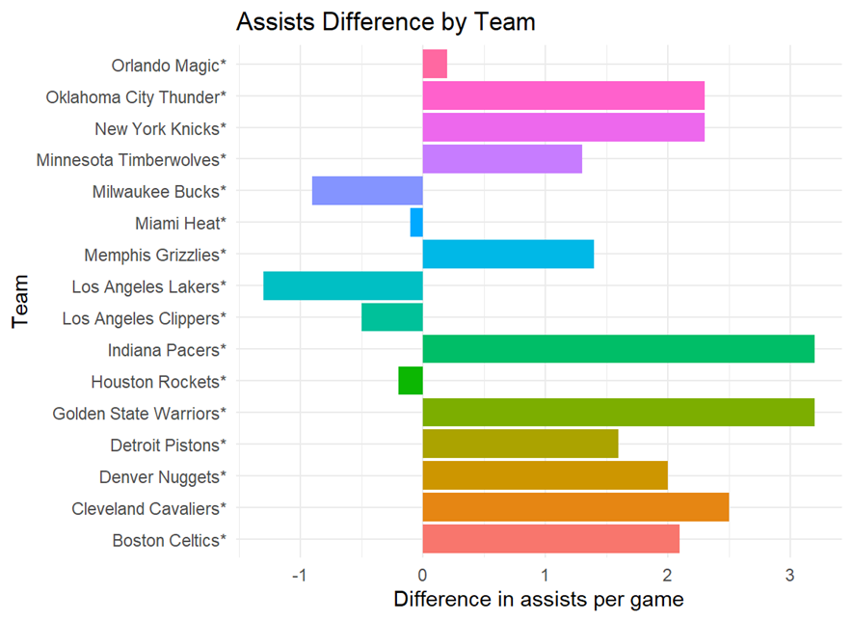
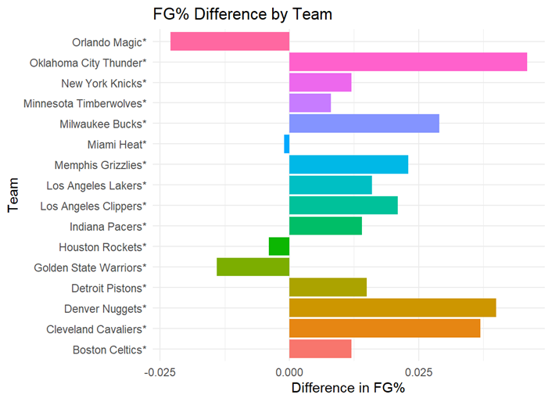
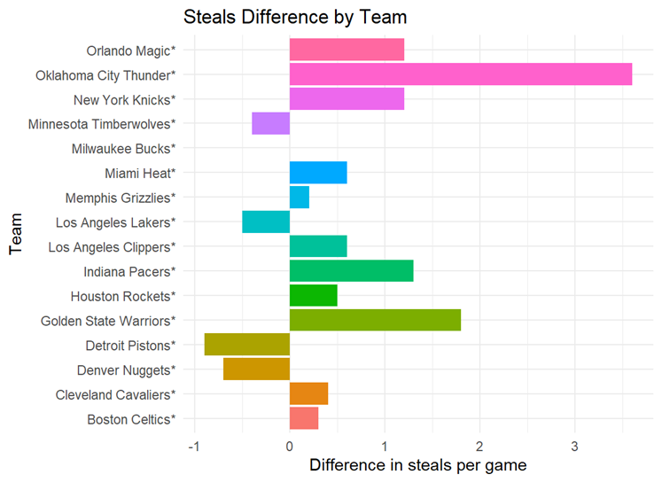
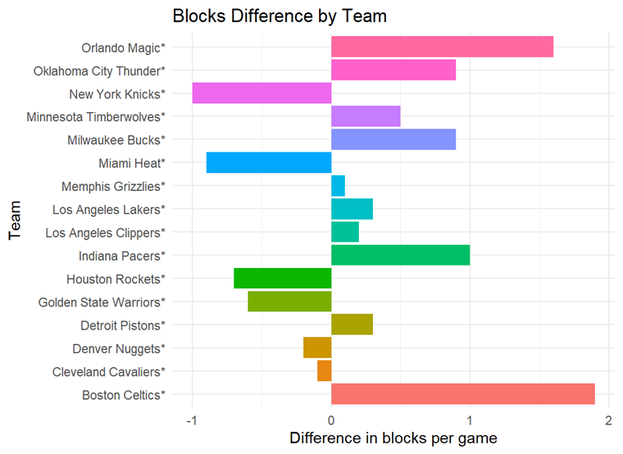
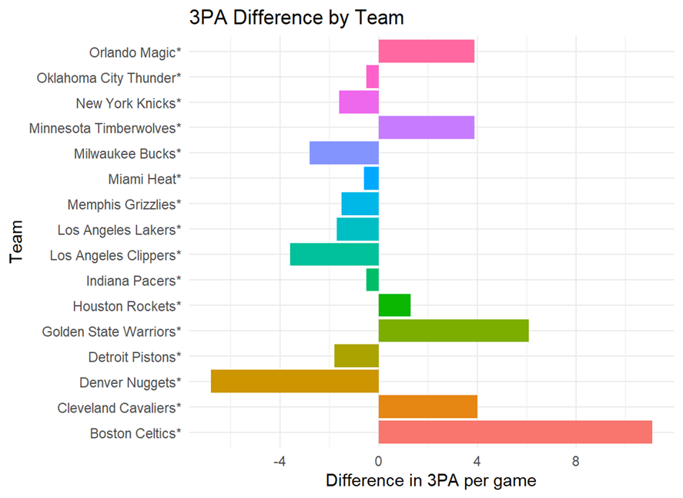
Every Playoff Team’s Stats

Slide 12
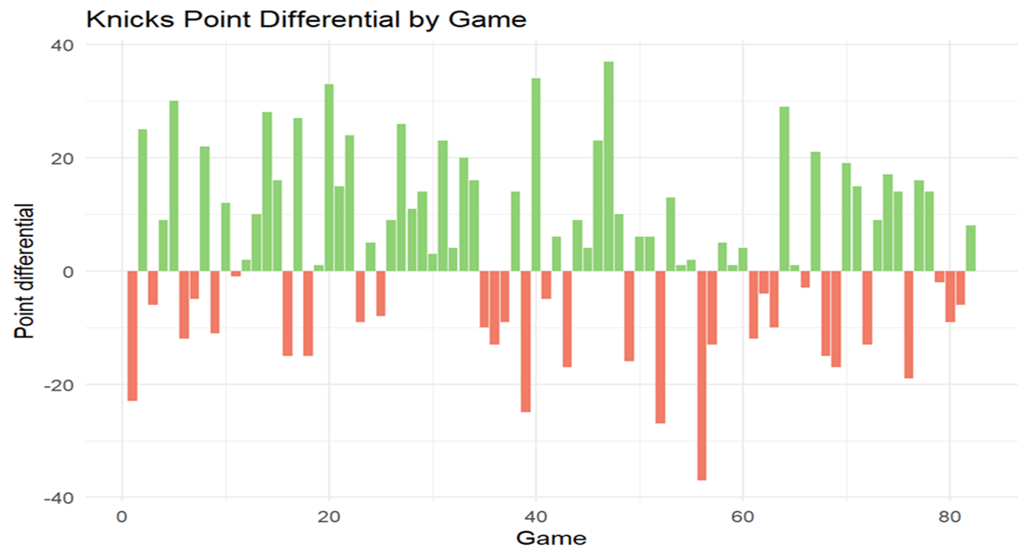
The Knicks Over The Course of The Season

Slide 13
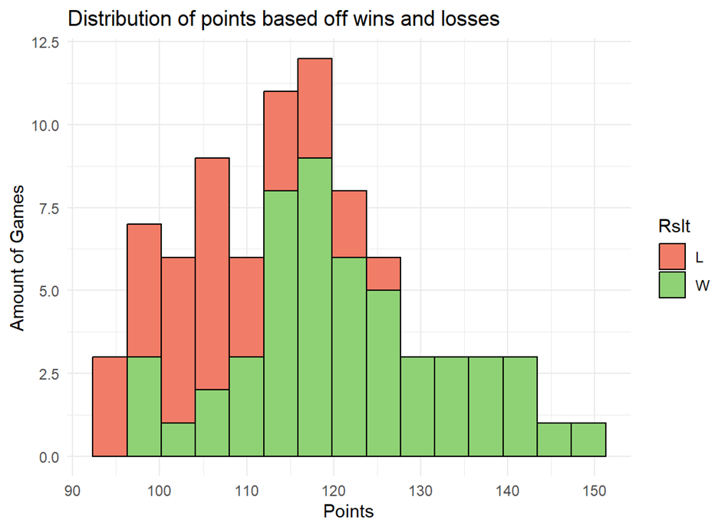
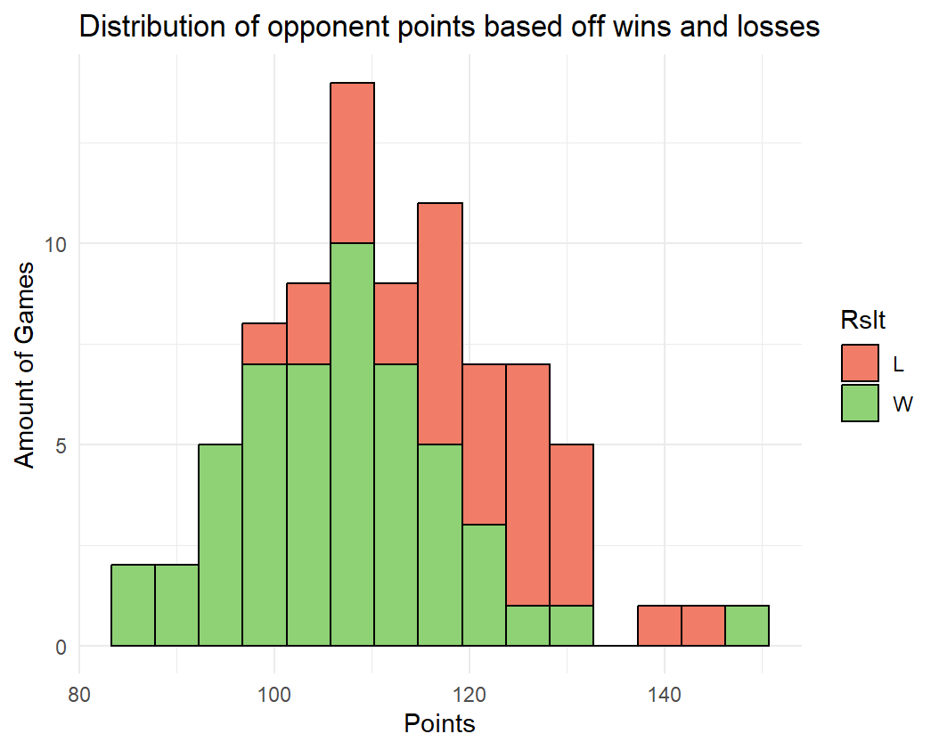
HISTOGRAMS OF POINTS PER GAME FROM THE KNICKS AND THEIR OPPONENTS COLOR CODED BY OUTCOME

Slide 14
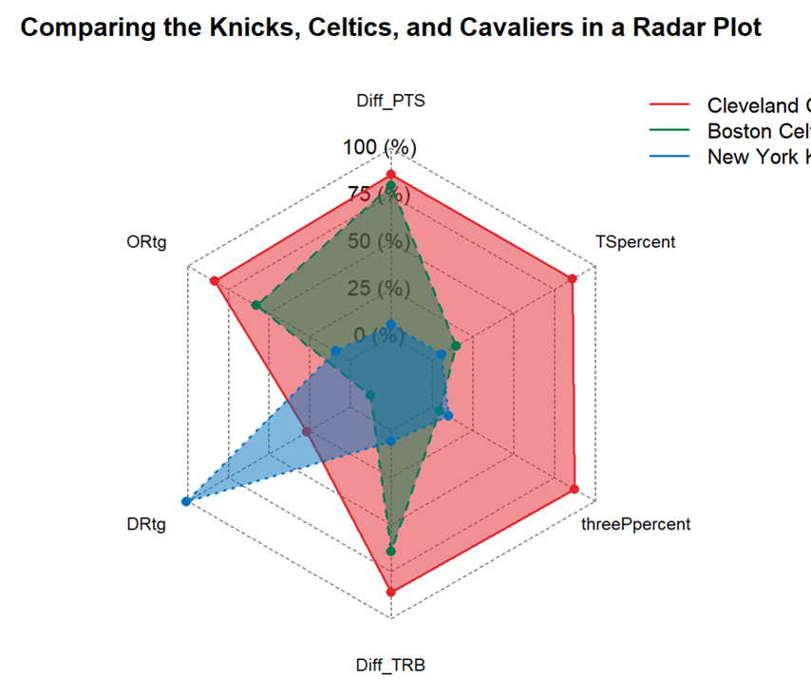
Radar plot of Knicks, Celtics, and Cavaliers

Slide 15
Insights
The Knicks are good but not great at almost every part of basketball.
They have a 0-10 record against any team with 60 wins. Likely to face these teams in the playoffs.
The Knicks winning a basketball game depends primarily on their efficiency as well as their defensive tenacity.
Against 60-win teams, the Knicks give up 10 more points than they usually do while scoring 10 less than they usually do.

Slide 16
PART 3: Data science Techniques

Slide 17
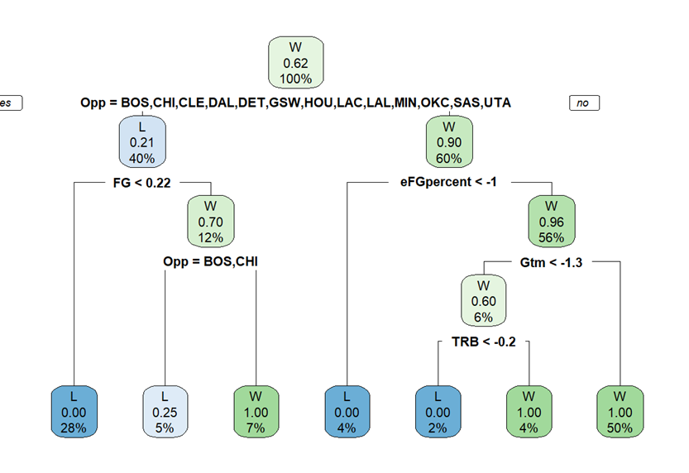
Decision Tree
Used to classify if a match would result in a win or a loss.
Interesting to see the model uses what opponent the Knicks are playing as a decision maker.
This is very insightful, as the Knicks almost exclusively beat bad teams and almost exclusively lose to good ones.

Slide 18
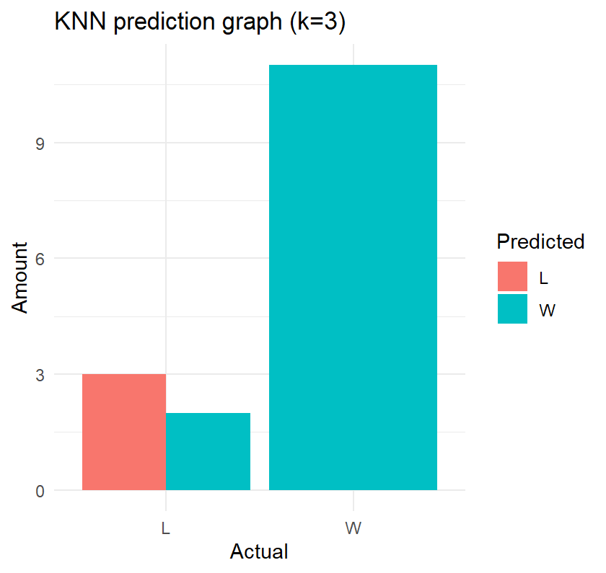

K Nearest Neighbor
Used KNN algorithms to see if it could predict if a game would be a win or a loss.
Model makes some incorrect predictions. Implies that the stats between when the Knicks win and when they lose may not be so far apart.
But most decisions made by KNN are correct.

Slide 19
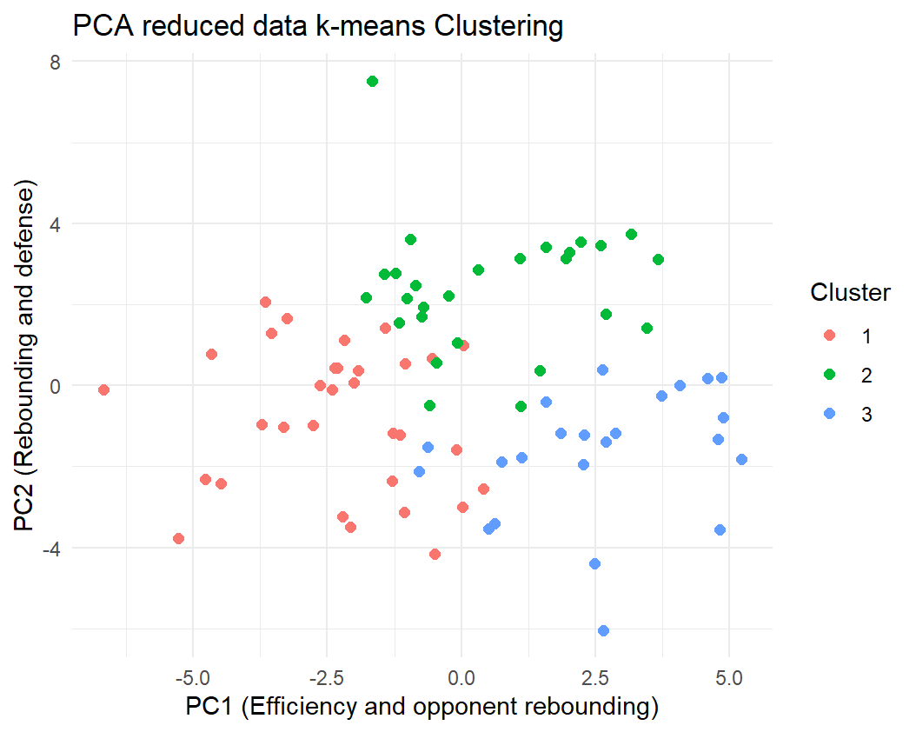
PCA and Clustering
Used PCA as a dimensional reduction tool. It identified relevant attributes for victory.
Then used k means clustering to put knicks games into clusters.

Slide 20
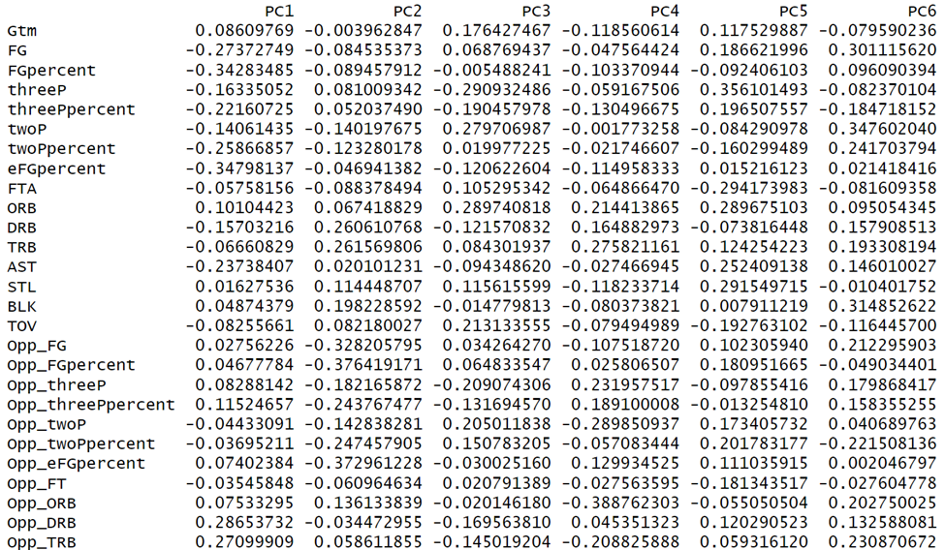
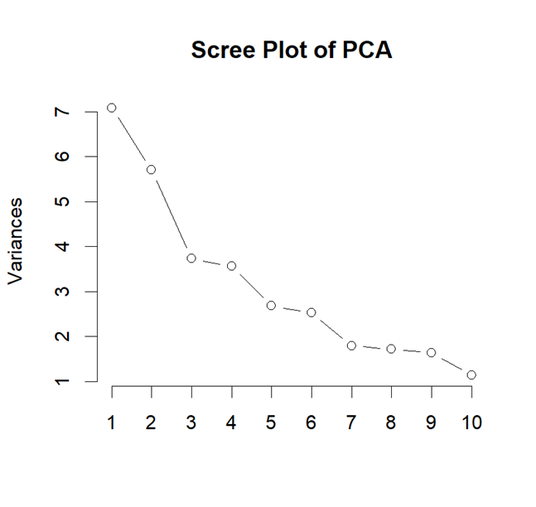
PCA Continued
On the top is the PCA variables. They list all variables from the original data and how important they are.
On the top is the Scree Plot of the PCA variables. It gives a rough estimate of how important each PCA variable is.

Slide 21
Thank You!

